Slide 1
Location Prediction over Sparse User Mobility Traces Using RNNs: Flashback in Hidden States!
Rao Xuan
2021-10-2

Slide 2
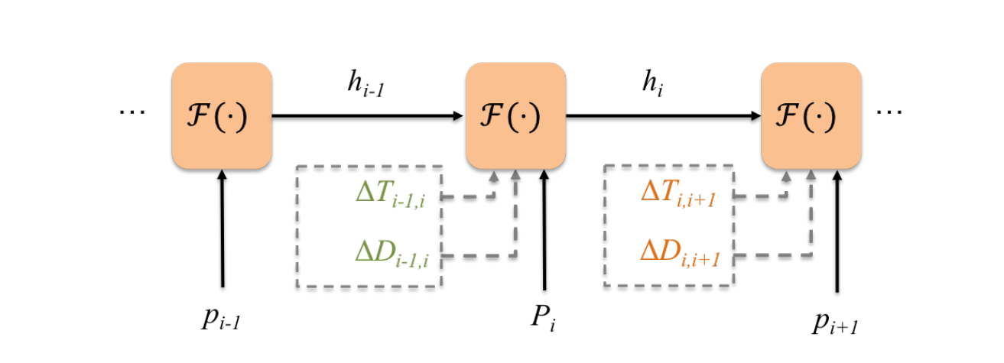
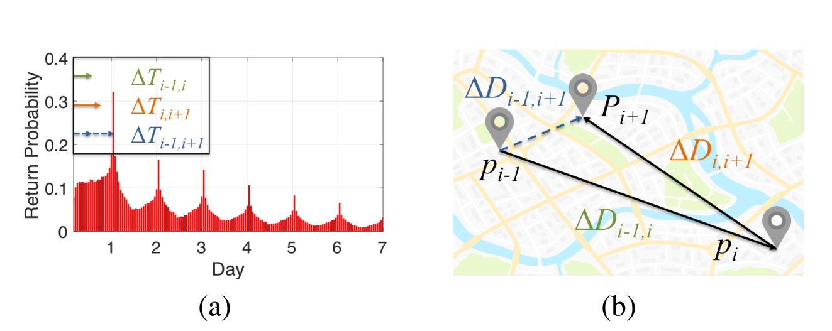
Drawbacks
Incorporate spatiotemporal factors into the recurrent hidden state passing process of RNNs.
Feeding temporal distances between successive check-ins to the RNN unit may ignore the temporal periodicity of user mobility.
Feeding spatial distances between successive check-ins to the RNN unit oversimplifies the spatial regularity of user mobility.
Spatiotemporal-specific transition matrices
Extending/adding gates

Slide 3
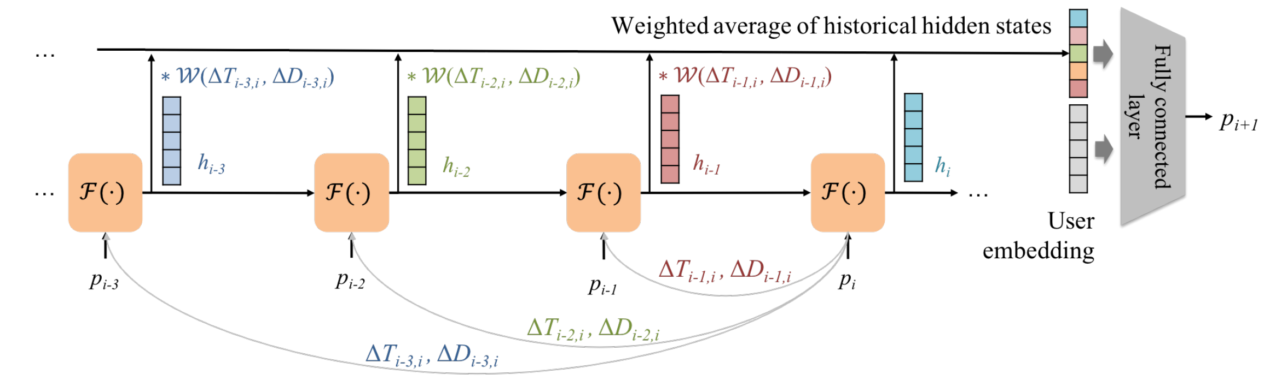
Solutions
Explicitly uses the spatiotemporal contexts to search past
hidden states with high predictive power (i.e., historical hidden states that share similar contexts as the current one).
define a learnable user embedding vector for each user, which is concatenated with the aggregated hidden state and then fed into a fully connected layer for predicting the next location.

Slide 4
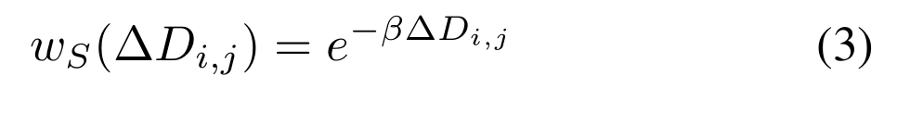
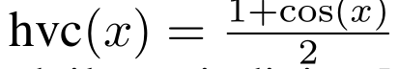
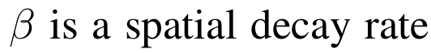
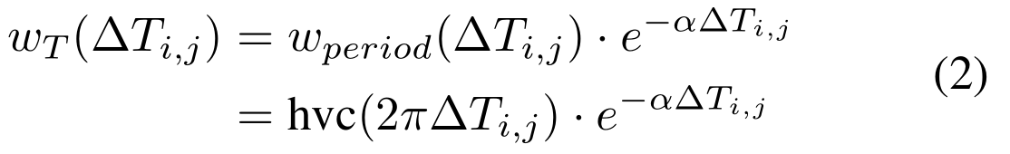
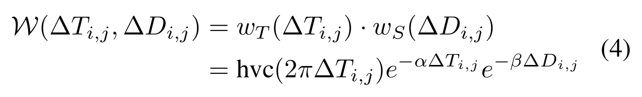
Context-Aware Hidden State Weighting
From a temporal perspective, our primary goal is to incorporate the periodicity property of user behavior into weight W.
From a spatial perspective, we consider the fact that the closer a check-in is to the current location, the more helpful it is for location prediction.
Besides the periodicity, the older a check-in is, the less impact it has for prediction. Subsequently, we add a temporal exponential decay weight to model this factor.
Combine the temporal and spatial weights together:

Slide 5
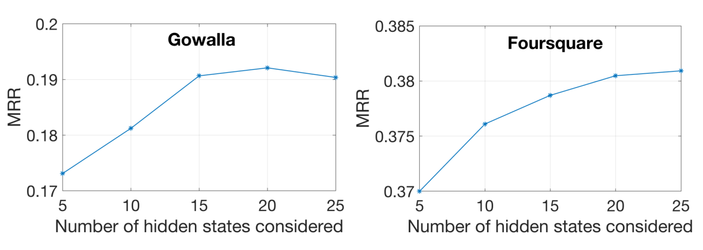
How Far to Flash Back?
∆t denote the average time between successive check-ins.
The hidden state k-step back has an average ∆T = ∆t · k.
The temporal exponential decay term becomes a function of k.
Set k = 20 for example, this term is around 0.01.
A hidden state more than k-step back receives on average a weight less than 0.01, which contributes little to the aggregated hidden state.

Slide 6
Discovering Subsequence Patterns for Next POI Recommendation
Rao Xuan
2021-10-3

Slide 7
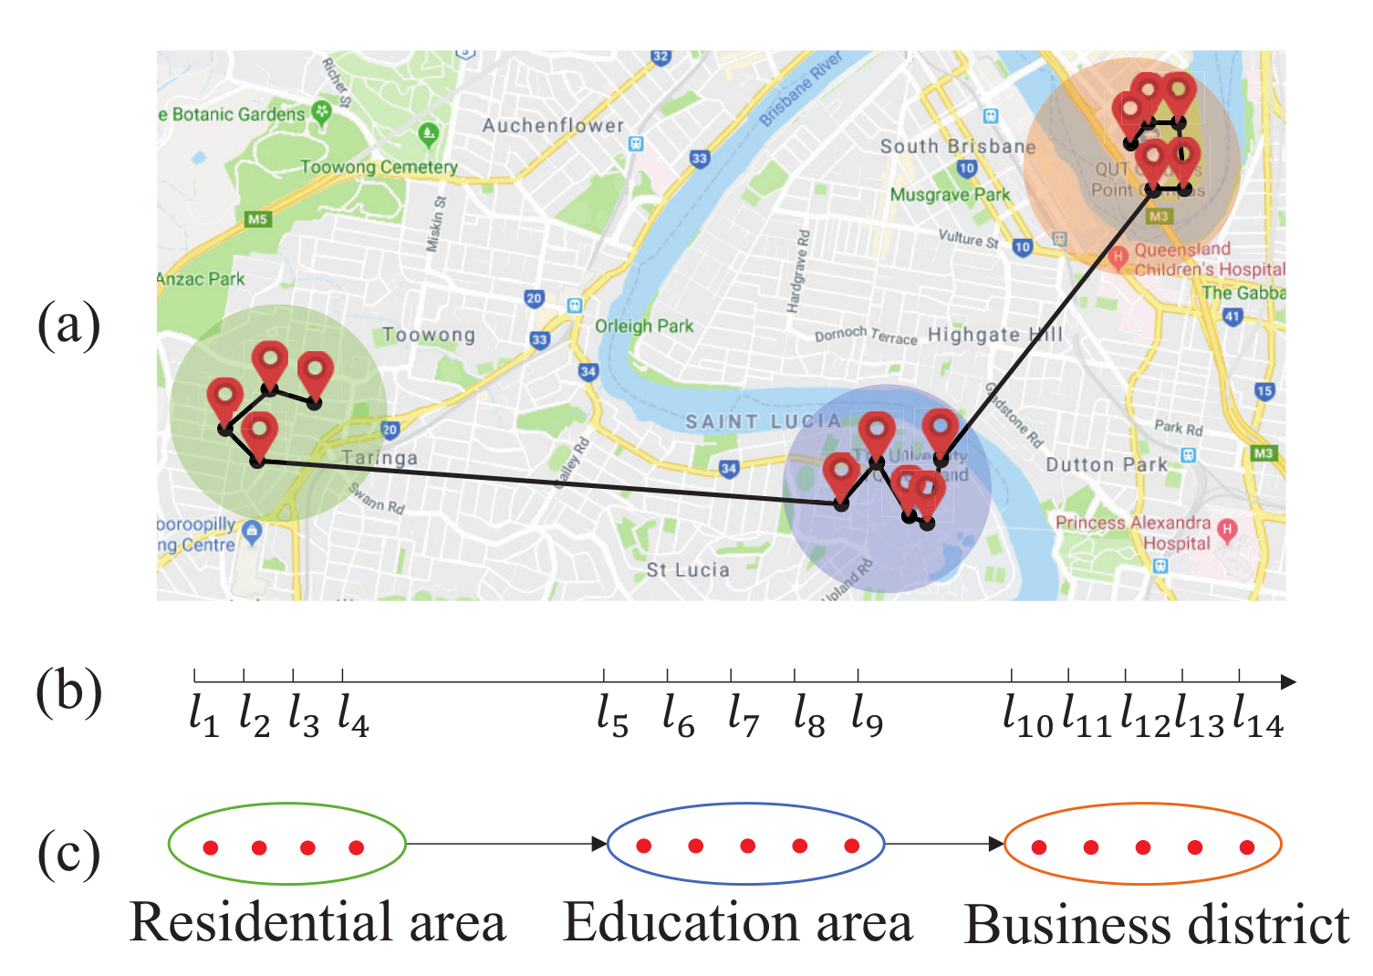
Research direction
The user’s check-in behaviors may be influenced by a subsequence of previously visited POIs as a whole rather than single POIs, which is beyond POI-level sequential patterns.
Such subsequences are not limited to the functional
zones, which could result from different factors such as user’s personal interests.
The set of POIs in the subsequence will perform as a whole when influencing the user’s future visit.

Slide 8
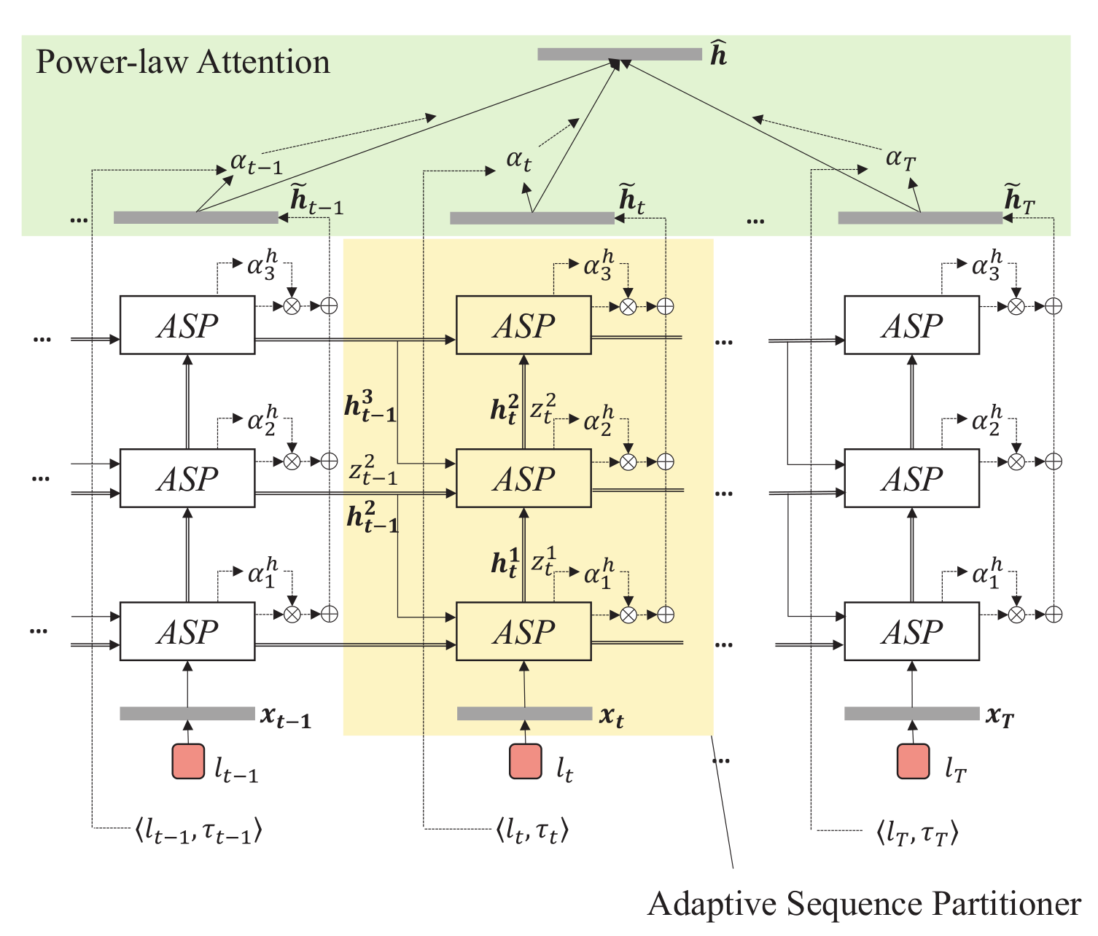
Framework
Learn the latent structures hierarchically by automatically partitioning the POI sequence without handcrafted features by a stacked recurrent neural network.
the higher layer learns from the lower in order to perform an abstraction with a larger level of granularity.
Power-law Attention mechanism to integrate the domain knowledge in both spatial and temporal contexts for the user’s check-in sequence.

Slide 9
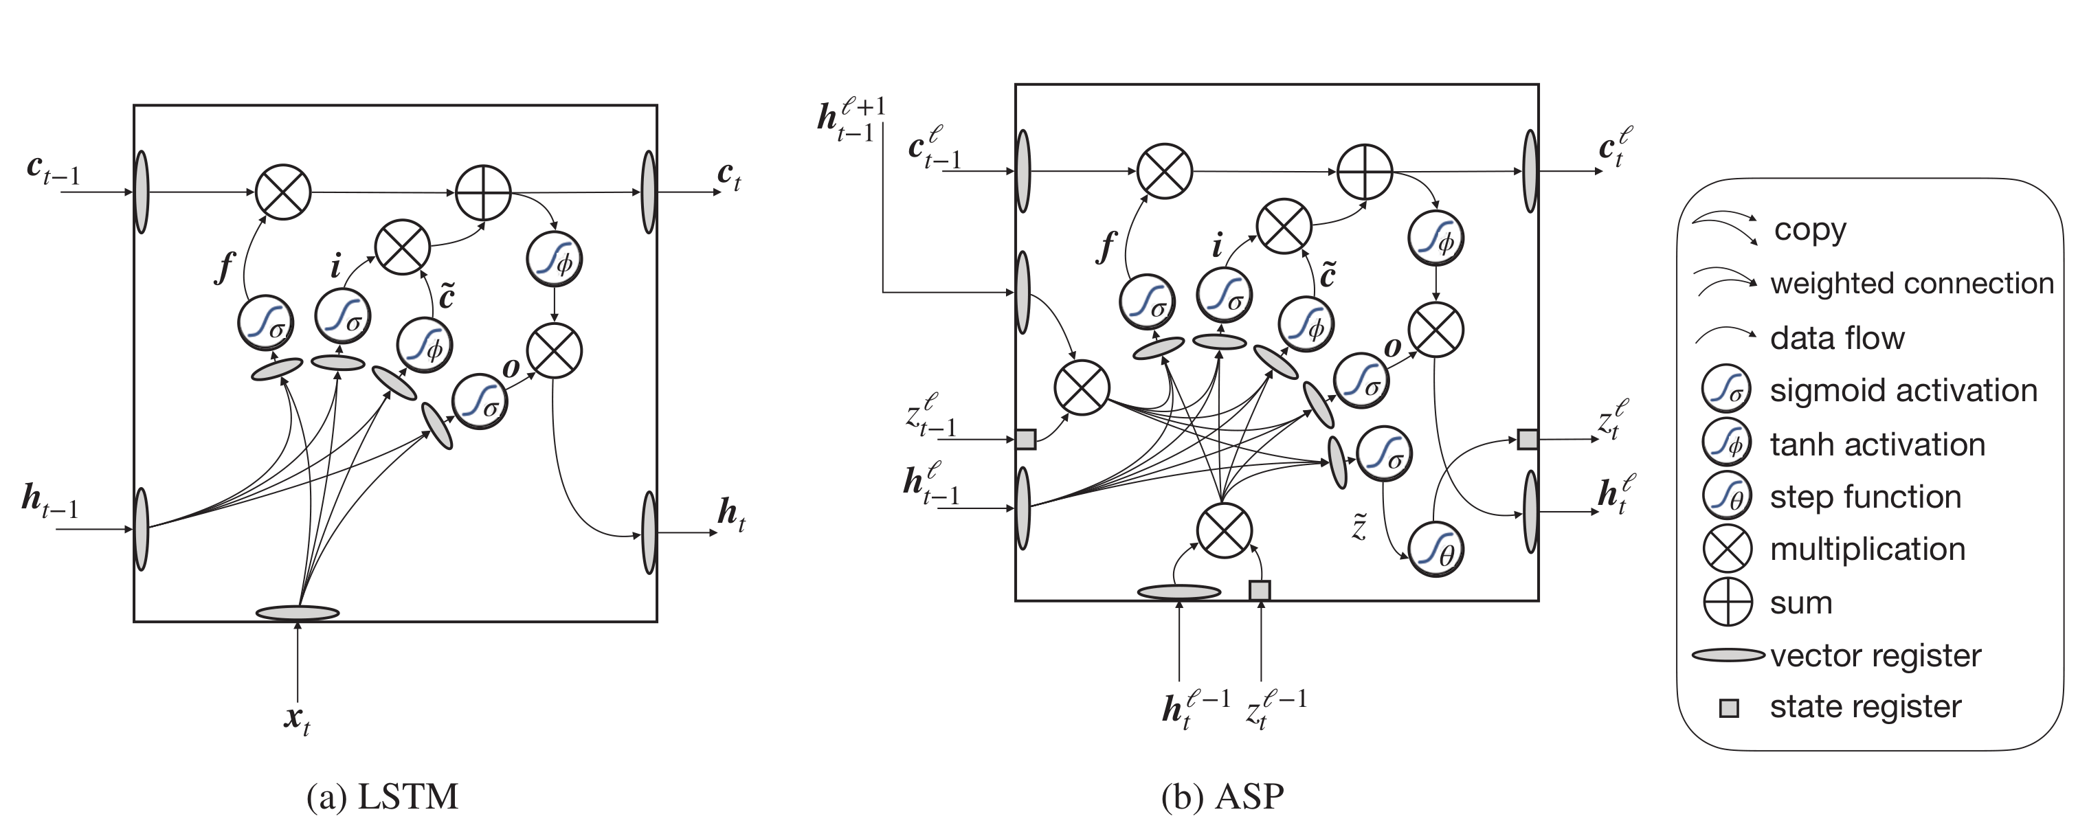
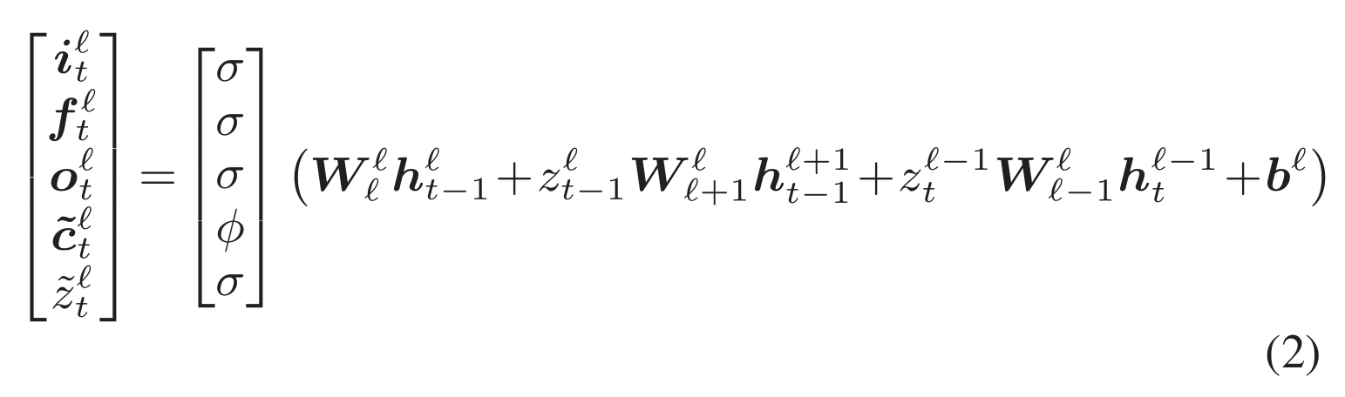
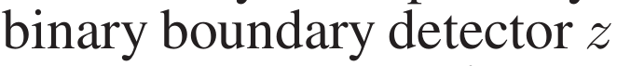
Adaptive Sequence Partitioner

Slide 10
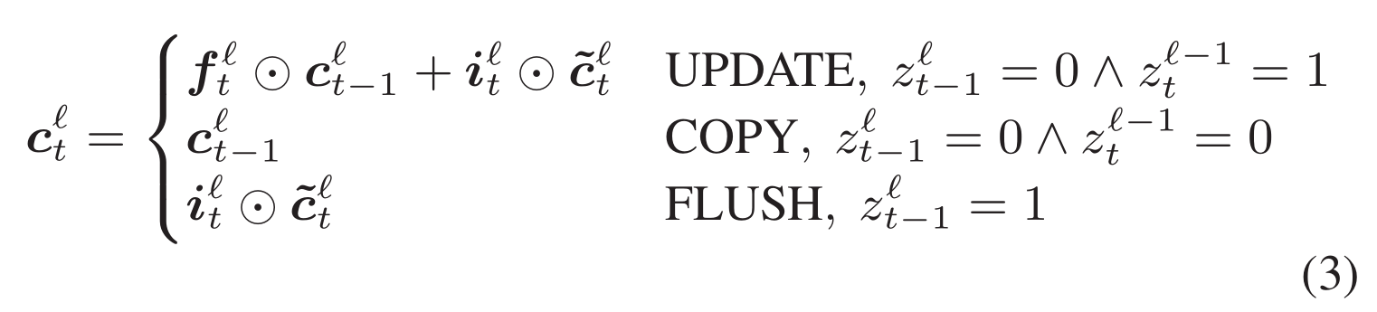
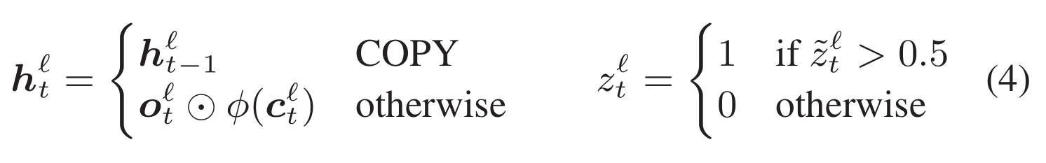
Adaptive Sequence Partitioner

Slide 11
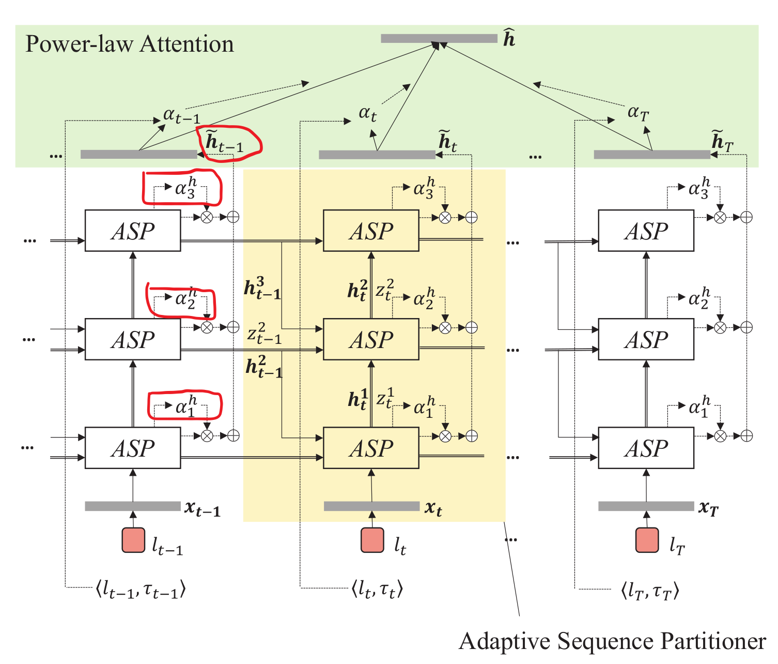
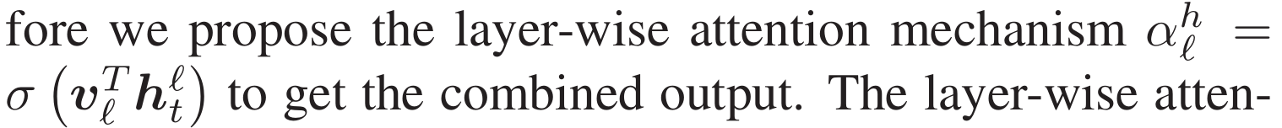
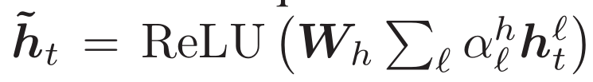
Adaptive Sequence Partitioner
Since the stacked layers in ASP capture different granularities, the sequence composition should be determined by all of them.
Layer-wise attention mechanism.
Aggregate the hidden states to get the output of each time step.

Slide 12
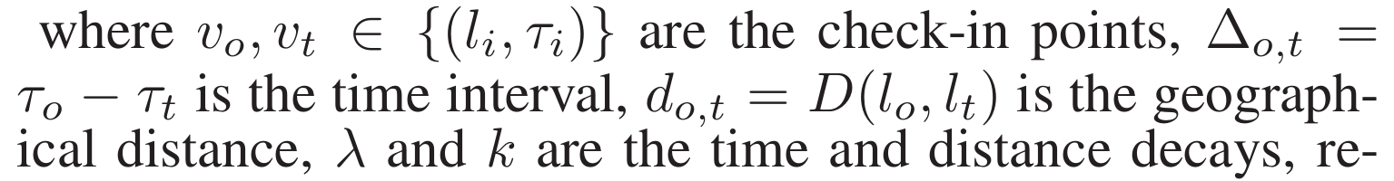
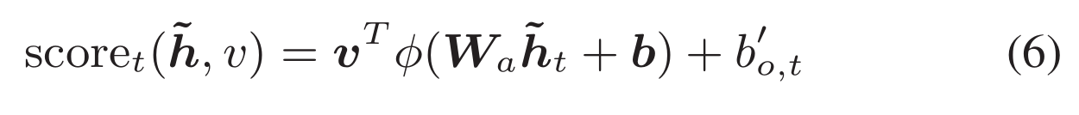
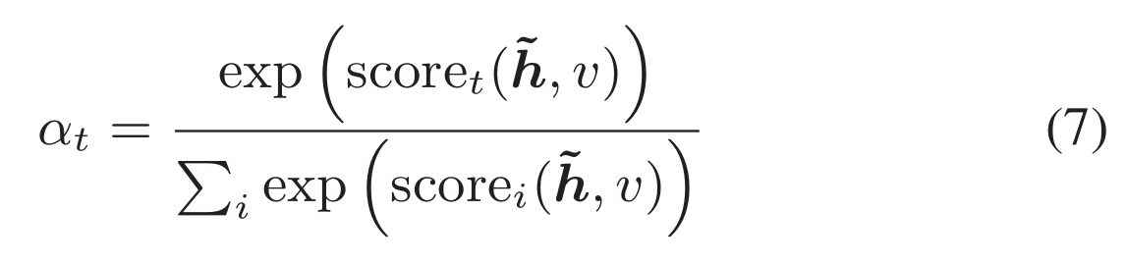
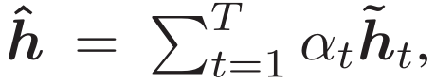
Power-law Attention Mechanism
integrate spatial and temporal contexts of each check-in into model.
Introduce spatio-temporal bias.
Compute weight score.

Slide 13
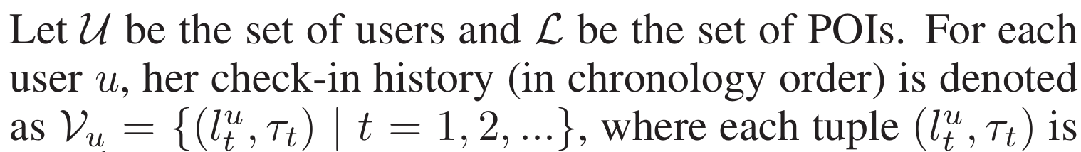
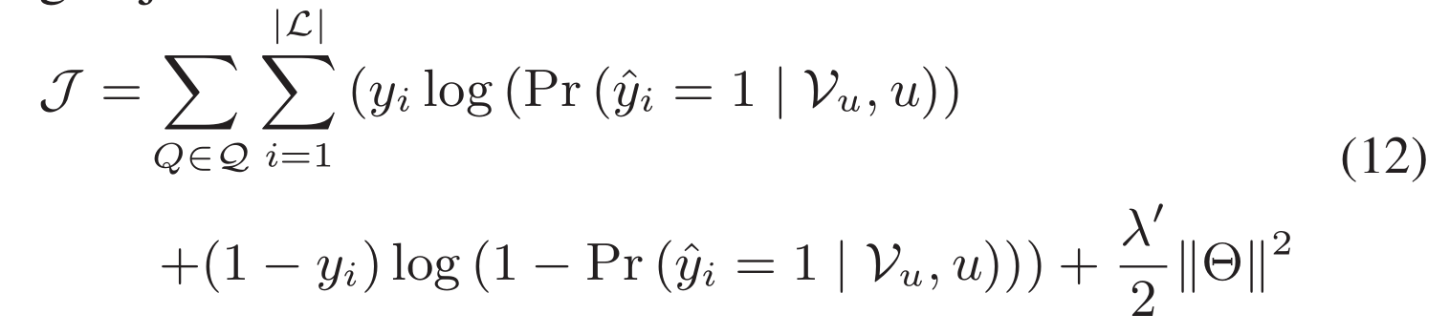
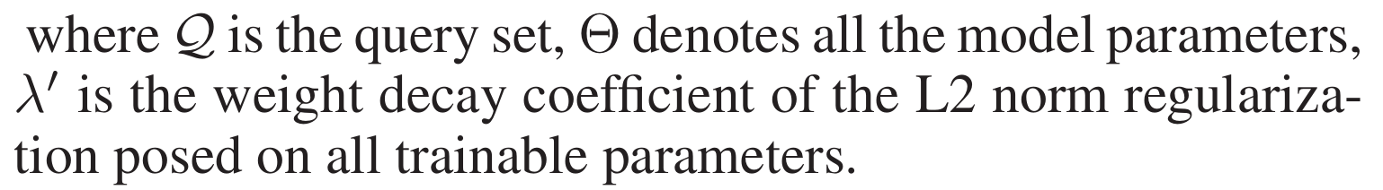
Training
The output layer of ASPPA consists of two fully connected
layers and a drop-out layer.
Objective function.

Slide 14
STP-UDGAT: Spatial-Temporal-Preference User Dimensional
Graph Attention Network for Next POI Recommendation
Rao Xuan
2021-10-4

Slide 15
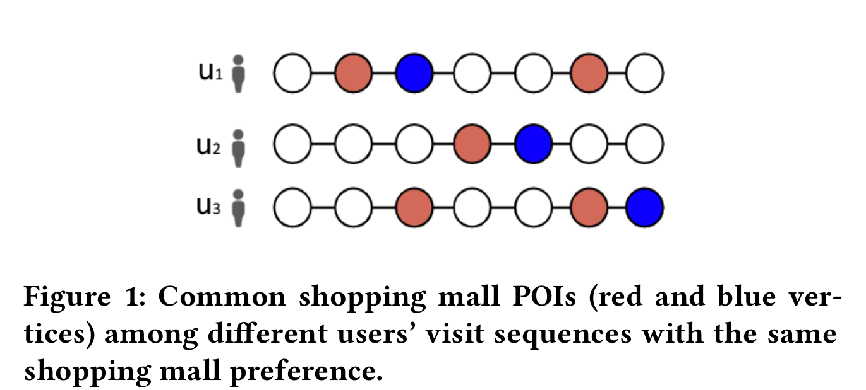
Research direction
Existing studies learn POI-POI relationships in a local view based on independent user visit sequences.
Propose to learn POI-POI relationships from both local and global views.
Learns POI-POI relationships based on spatial, temporal and preference factors by concurrently exploiting personalized user preference and exploring new POIs in global spatial-temporal-preference neighbourhoods.
Learns user-user relationships, allowing users to selectively learn from other similar users.
similar users with a common preference in shopping mall POIs can be used to support recommendations to a user who likes shopping malls.

Slide 16
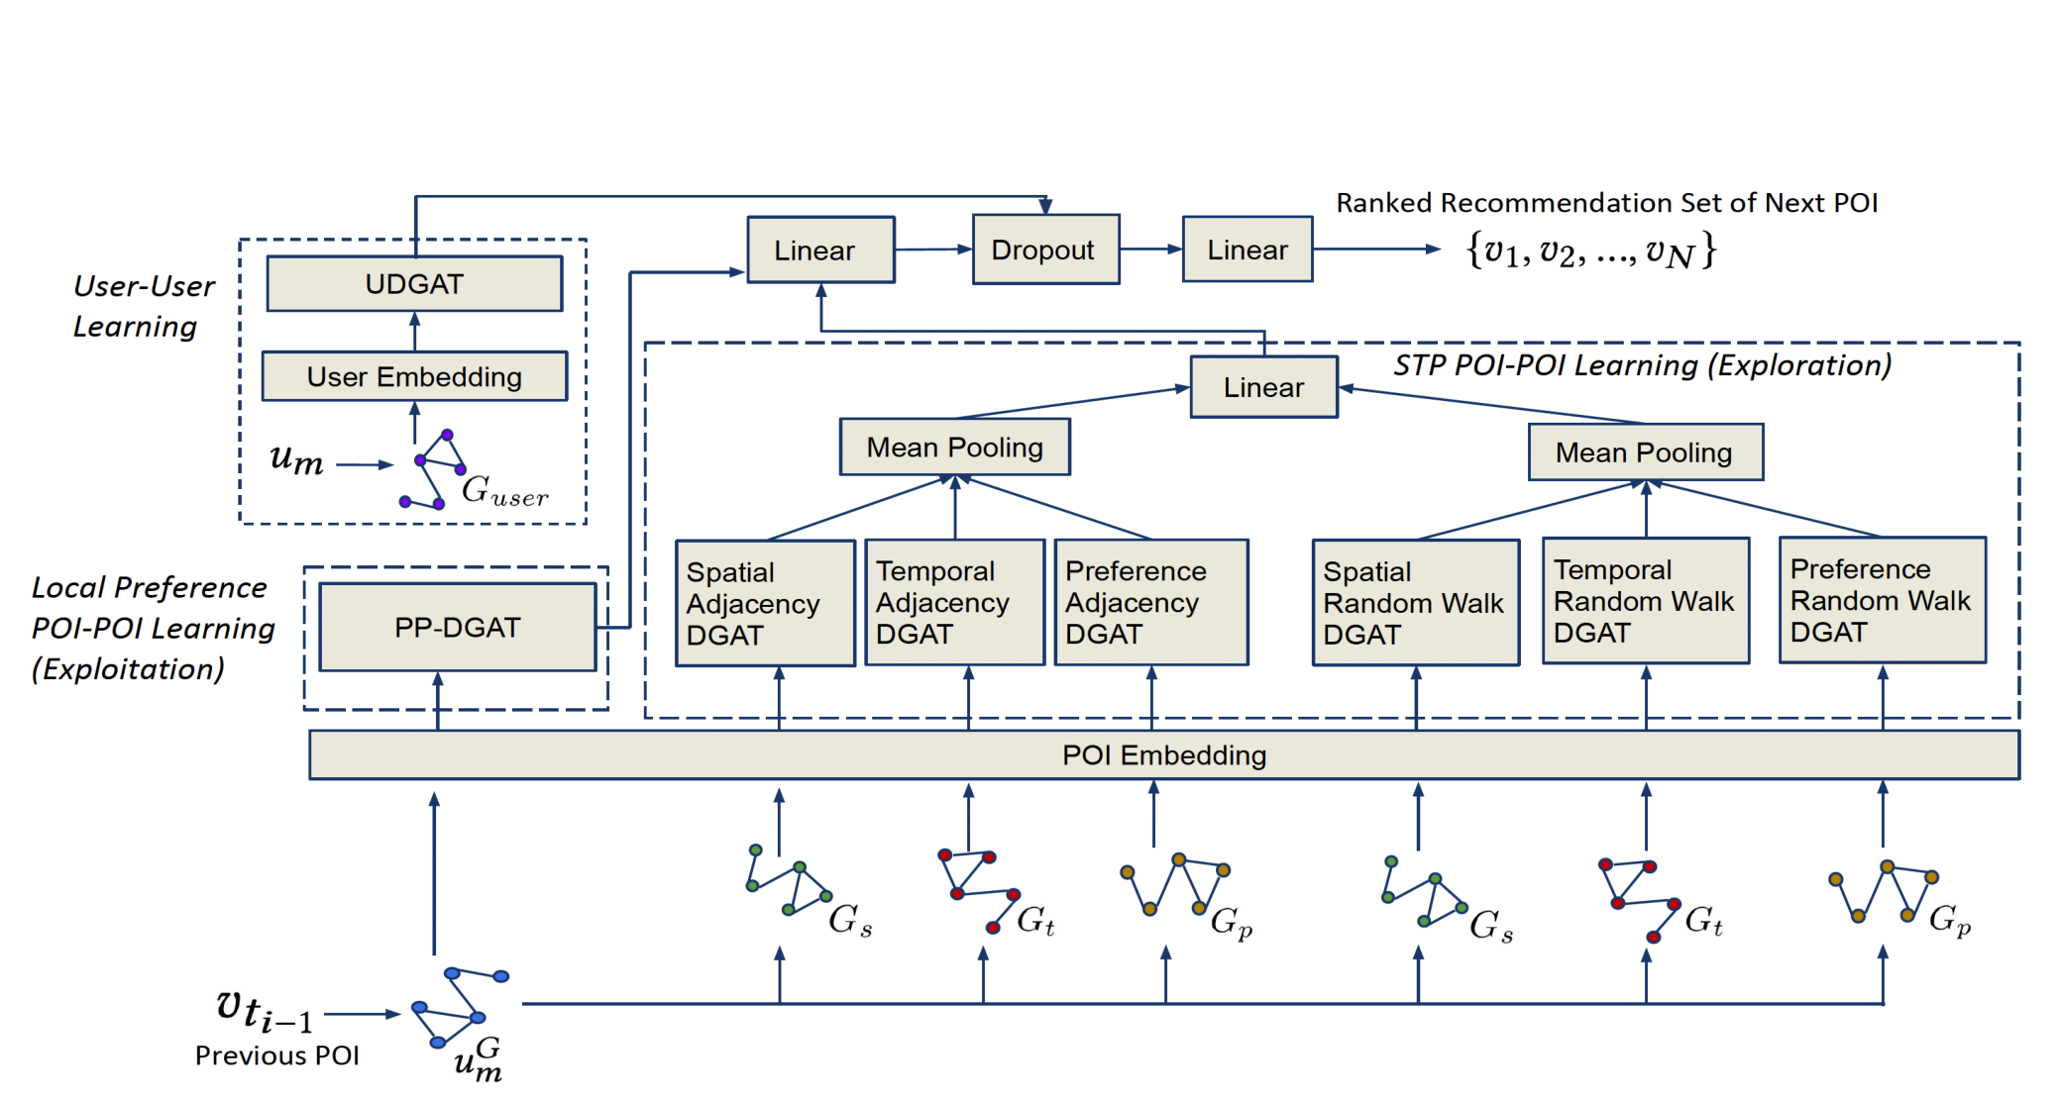
Framework
Local Preference POI-POI
Learning(Exploitation)
STP POI-POI Learning(Exploration)
User-User Learning
Use GAT as main blocking network

Slide 17
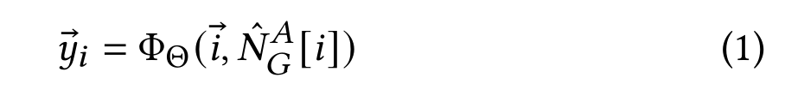
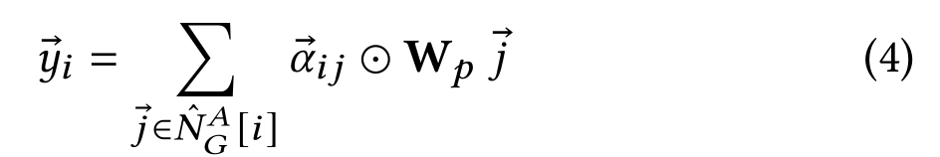
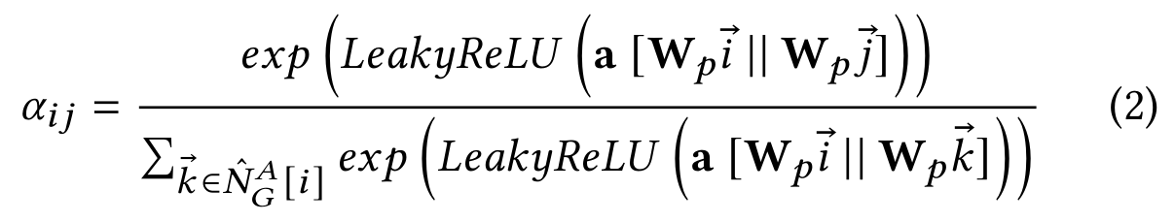
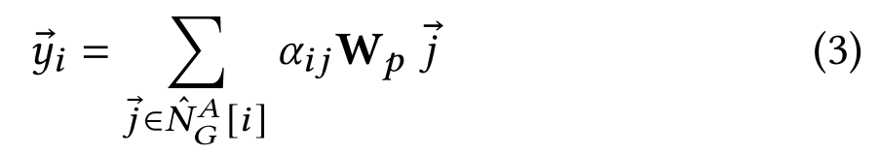
DGAT
GAT
DGAT
Compute a hidden representation for a vertex by attending to each vertex in its neighbourhood set from a graph G .
The scalar coefficients are representative of
the whole vector representation for each neighbor.
Each dimension of neighbor vector j would have its own coefficient.
A is adjacency option.

Slide 18
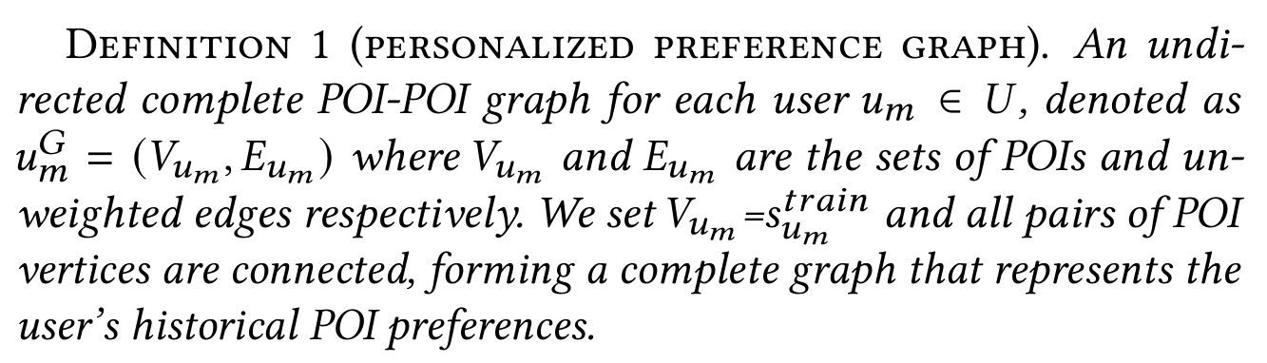
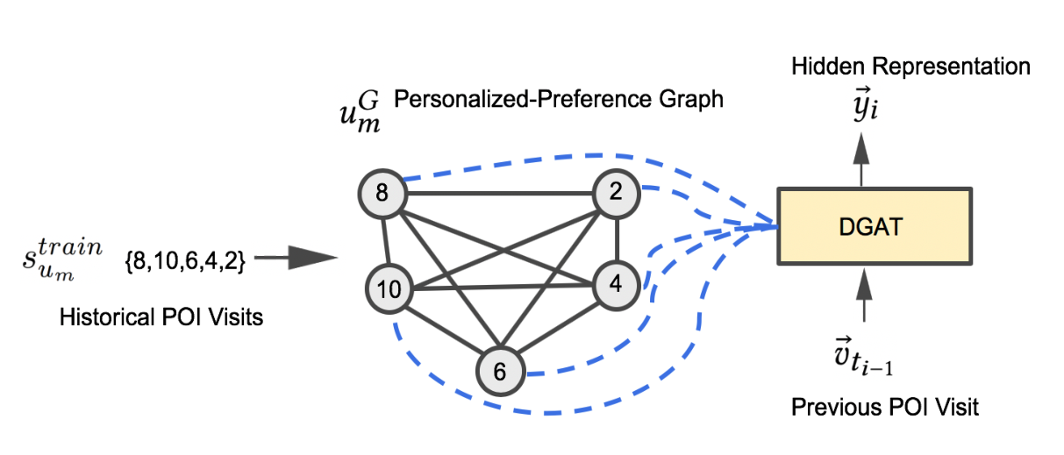
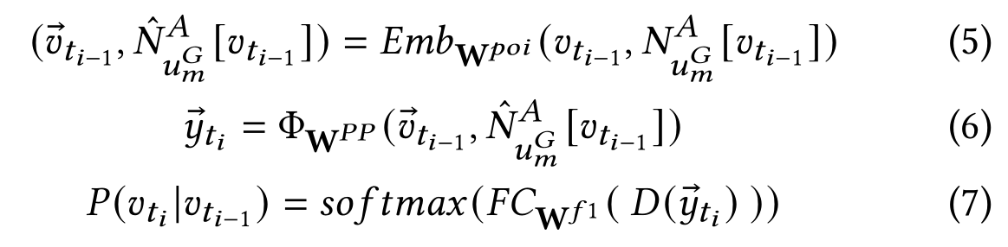
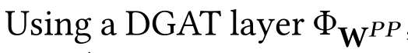
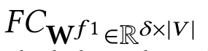
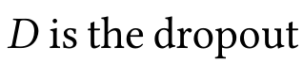
PP-DGAT
Learning From Local View

Slide 19
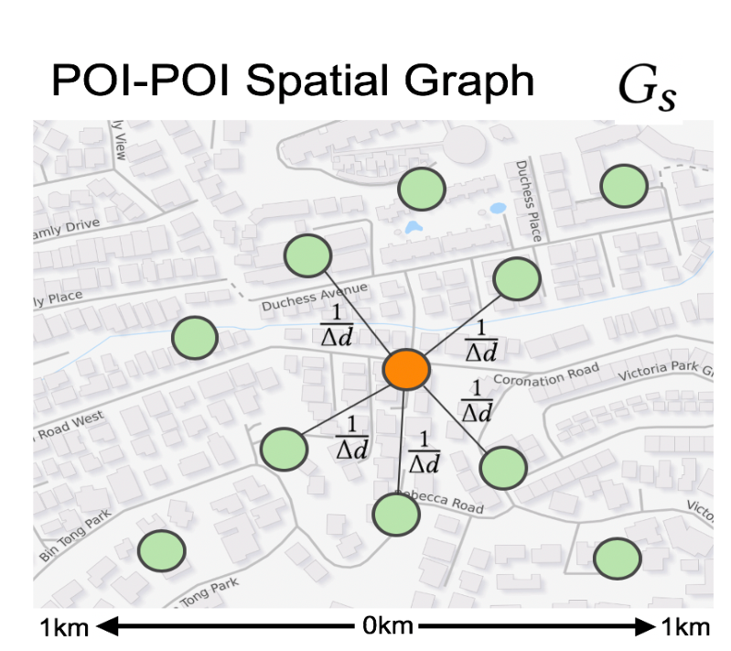
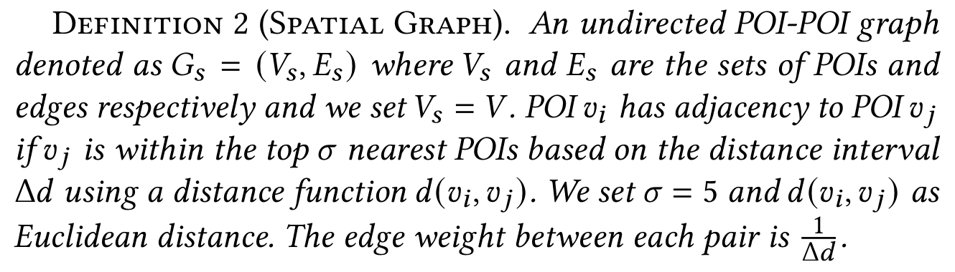
STP-DGAT
Learning From Global View
Global STP factors across all users to improve the recommendation task and user experience through the exploration of new unvisited POIs to better learn the POI-POI relationships.
a new POI refers to an unvisited POI in the user’s historical POI visits.
Construct spatial graph, temporal graph, and preference graph, respectively.

Slide 20
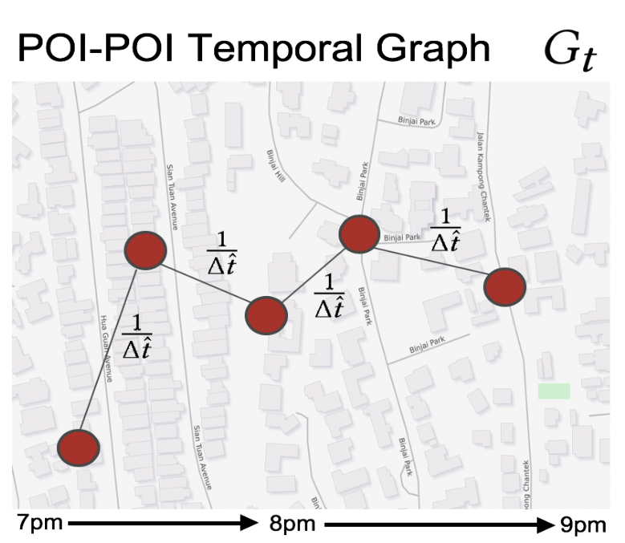
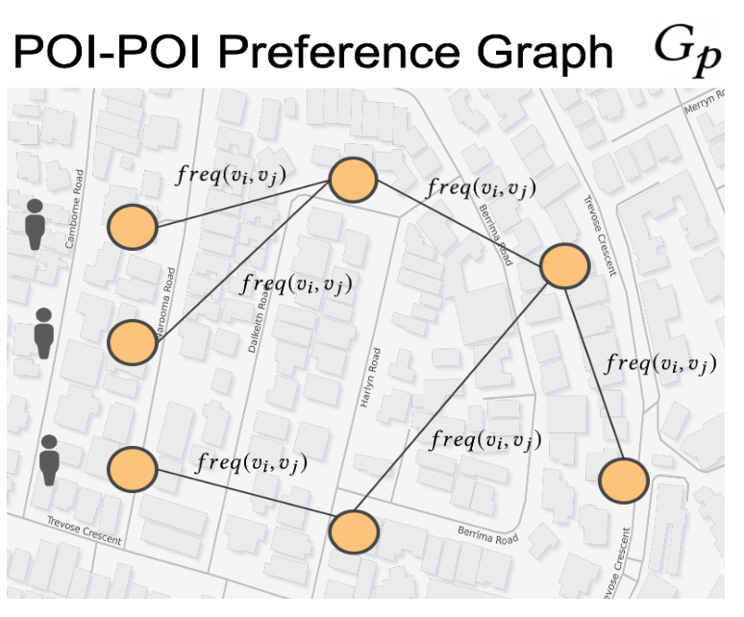
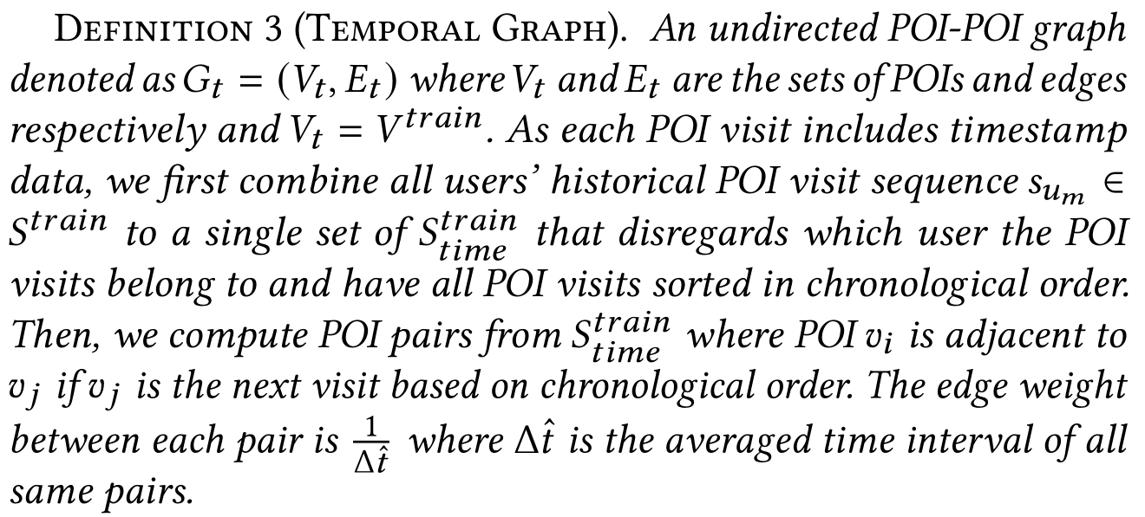
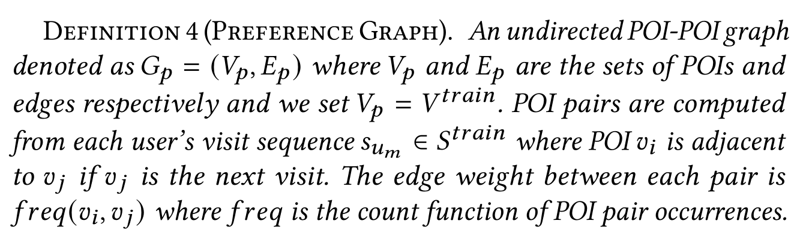
STP-DGAT

Slide 21
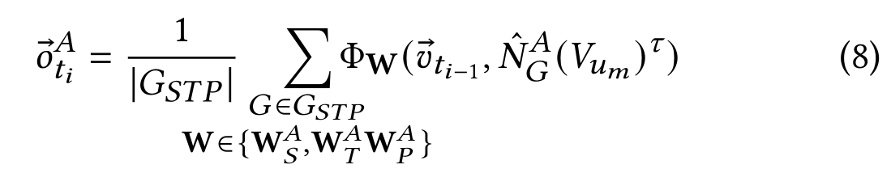
STP-DGAT
Exploring New STP Neighbours
Use all vertices in the each user’s PP graph as the set of seed POIs to find relevant new POIs in STP graphs.
Compute the closed neighbourhood of each POI in the user’s PP graph vertex set through the adjacency option A from STP graphs, respectively.
Remove all visited POIs by the user and perform a frequency ranking to compute the top-k new neighbours.
Use separate DGAT layers and perform mean pooling to output a single STP representation.

Slide 22
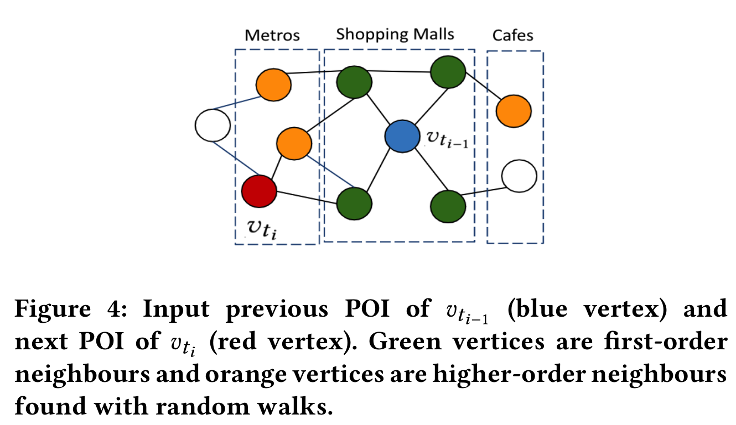
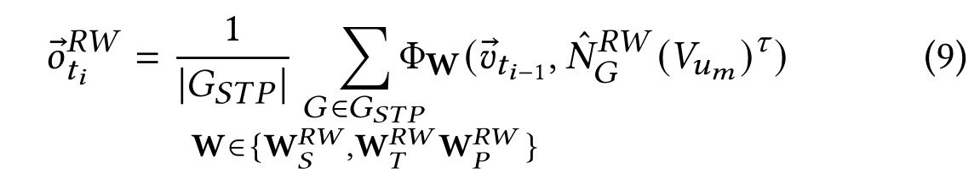
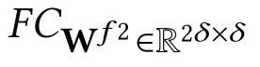
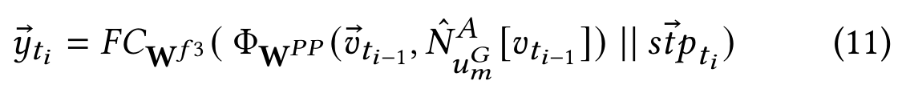
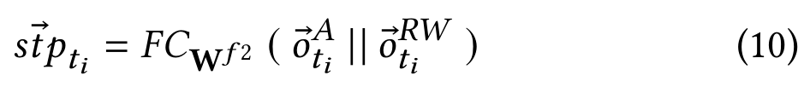

STP-DGAT
Exploring New STP Neighbours
Explore new first-order neighbours using adjacency option A.
Use random walk masked self-attention option RW to focus on higher-order neighbours due to first-order neighbours are insufficient to represent the neighbourhood of vertex.
Explore-Exploit
Balance the explore-exploit trade-offs between PP-DGAT’s representation (exploiting users’ historical POIs) and the STP representation.
Leverage both newly explored first-order and higher order POI neighbours.

Slide 23




STP-UDGAT
Propose User DGAT (UDGAT) with the goal of allowing users to learn to attend to other similar users.

Slide 24
Framework
Local Preference POI-POI
Learning(Exploitation)
STP POI-POI Learning(Exploration)
User-User Learning
Use GAT as main blocking network

Slide 25
Where to Go Next: Modeling Long- and Short-Term
User Preferences for Point-of-Interest Recommendation
Rao Xuan
2021-10-5

Slide 26

Research direction
Current trajectory
History trajectories
Users’ long-term preference: develop a context-aware nonlocal network structure to explore the temporal and spatial correlations between historical and current trajectories.
Users’ short-term preference: propose a geo-dilated RNN to fully exploit the geographical relations among non-consecutive POIs.

Slide 27



Long-Term Preference Modeling
Encode the information of all POIs in each historical trajec-
Using a LSTM layer.
Map one week into 48 time slots and construct a POI set for each slot.
Calculate the temporal similarity between the i-th and j-th time slots.
The popularity of POIs is changing over time in real-life scenarios.
Develop a time-weighted operation to incorporate such information to capture the time-sensitive property.

Slide 28




Long-Term Preference Modeling
According to the check-in time of each POI in a historical trajectory, derive a sequence of check-in time slots.
Calculate the trajectory-level representation.
Capture the influence of each historical trajectory on the current trajectory based on the pairwise affinities.
model the recently visited POIs.

Slide 29








Long-Term Preference Modeling
Further derive the location-based long-term user preference by taking the user’s most recently visited location into account.
define a central coordinate for each historical trajectory.

Slide 30





Short-Term Preference Modeling
Standard LSTM
Geo-dilated LSTM
Combine

Slide 31



Prediction
Compute the probability distribution.
Loss function.

Slide 32
An Attentional Recurrent Neural Network
for Personalized Next Location Recommendation
Rao Xuan
2021-10-6

Slide 33

Research direction
Similar locations (neighbors) share similar transitional patterns.
The transition regularities of neighbors serve as complementary information for locations with insufficient following check-ins..

Slide 34

Framework
Embedding layer
Attention layer
Recurrent layer
Output layer

Slide 35



Knowledge Graph
Similar locations
geographically close.
described by the same semantics.
preferred by the same user.

Slide 36



Neighbor Discovery
Utilize meta-path to extract various kinds of neighbors.
For each location, a random walk process is conducted to generate paths based on the LL, LV L and LUL meta-paths.

Slide 37


Attention Layer
Calculate the similarity between current location and each neighbor.
Choose salient neighbors based on current location automatically at each time step along the sequence.

Slide 38

Recurrent Layer
The goal of the recurrent unit is to jointly integrate the three groups of representations to update the hidden state.

Slide 39



Output Layer & Model Optimization
Combine the last hidden state with user general preference to predict where user would visit at next time.
Loss function

